Slide 1

Natural Disasters
By: Angelneke Grayson, Ehsan Aref Adib, Max Fishman, Natalie Binder, and Nathan Humphreys Lucas

Slide 2
Energy of this Analysis
“This project aims to gain insights into the patterns and trends of natural disasters in the US over the past 70 years. It involves:
identifying the most common types of disasters and total occurrences within different regions throughout the U.S.,
analyzing the frequency of disasters over the years,
investigating correlations between disaster types and their occurrences in certain times of the year and
assessing the effectiveness of disaster declarations and responses.
The analysis will utilize various data visualization techniques such as bar charts, time series line plots, pie charts, and stacked bar charts to present the findings effectively.”
Notes:
Nat

Slide 3
Who are we? What is our purpose?
Are there any missing or incomplete data points, and if so, how will they be handled during the analysis?
We are FEMA. Federal Emergency Management Agency
How can we anticipate the future?
The President can declare an emergency for any occasion or instance when the President determines federal assistance is needed.
Emergency declarations supplement State and local or Indian tribal government efforts in providing emergency services, such as the protection of lives, property, public health, and safety, or to lessen or avert the threat of a catastrophe in any part of the United States.
The total amount of assistance provided for in a single emergency may not exceed $5 million. The President shall report to Congress if this amount is exceeded.
Provide quicker relief to affected states in times of emergency
Notes:
Nat / maybe more bulletins for future??

Slide 4
August 2023’s Stats
Individual Assistance in $235.4M
Grants to disaster survivors (in millions) so far in 2023.
2023 Mitigation Grants
847 Number of hazard mitigation assistance sub-grants so far in 2023.
2023 Disaster Declarations
63 Disaster declarations for states and counties.
2023 Fire Incidents
16 Fire Incidents for states and counties.
Notes:
nat

Slide 5


25 total types of natural disasters found in our dataset.
Notes:
angel

Slide 6
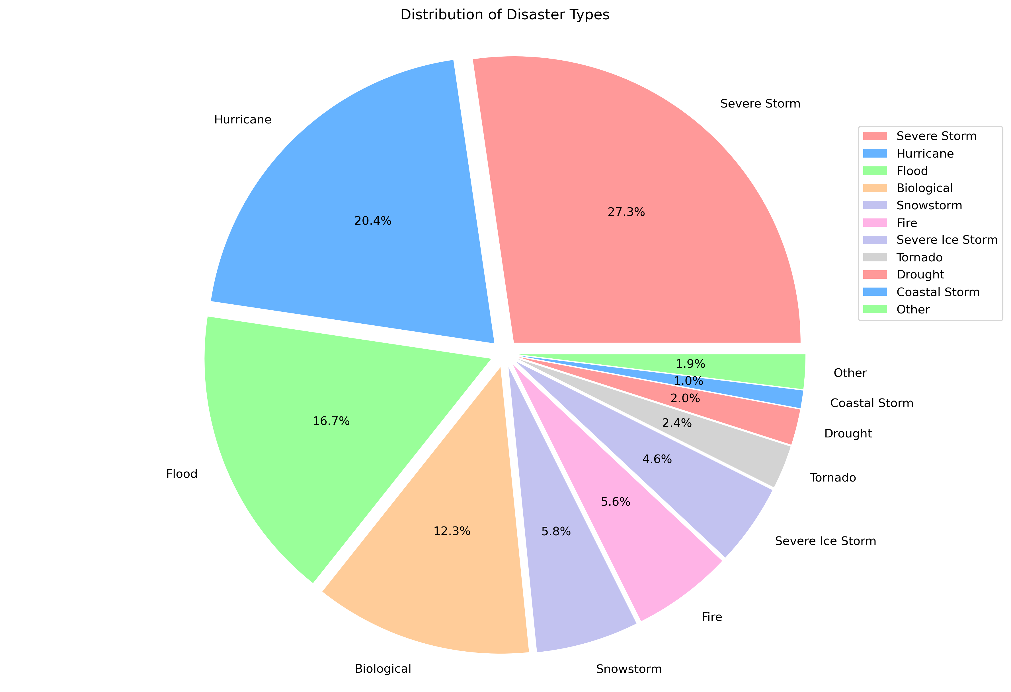
The top 10:
Severe Storms take the cake; claiming 27.3% of all natural disasters over the last 70 years
Hurricanes followed close by at 20.4%
Remaining:
Floods
Biological (covid)
Snowstorms
Fires
Ice Storms
Tornados
Drought
Coastal Storms
* displaying all 25 disaster types in a single pie chart proved to be too clustered. The remaining 15 disaster types were grouped into an “Other” category (see next slide)

Slide 7

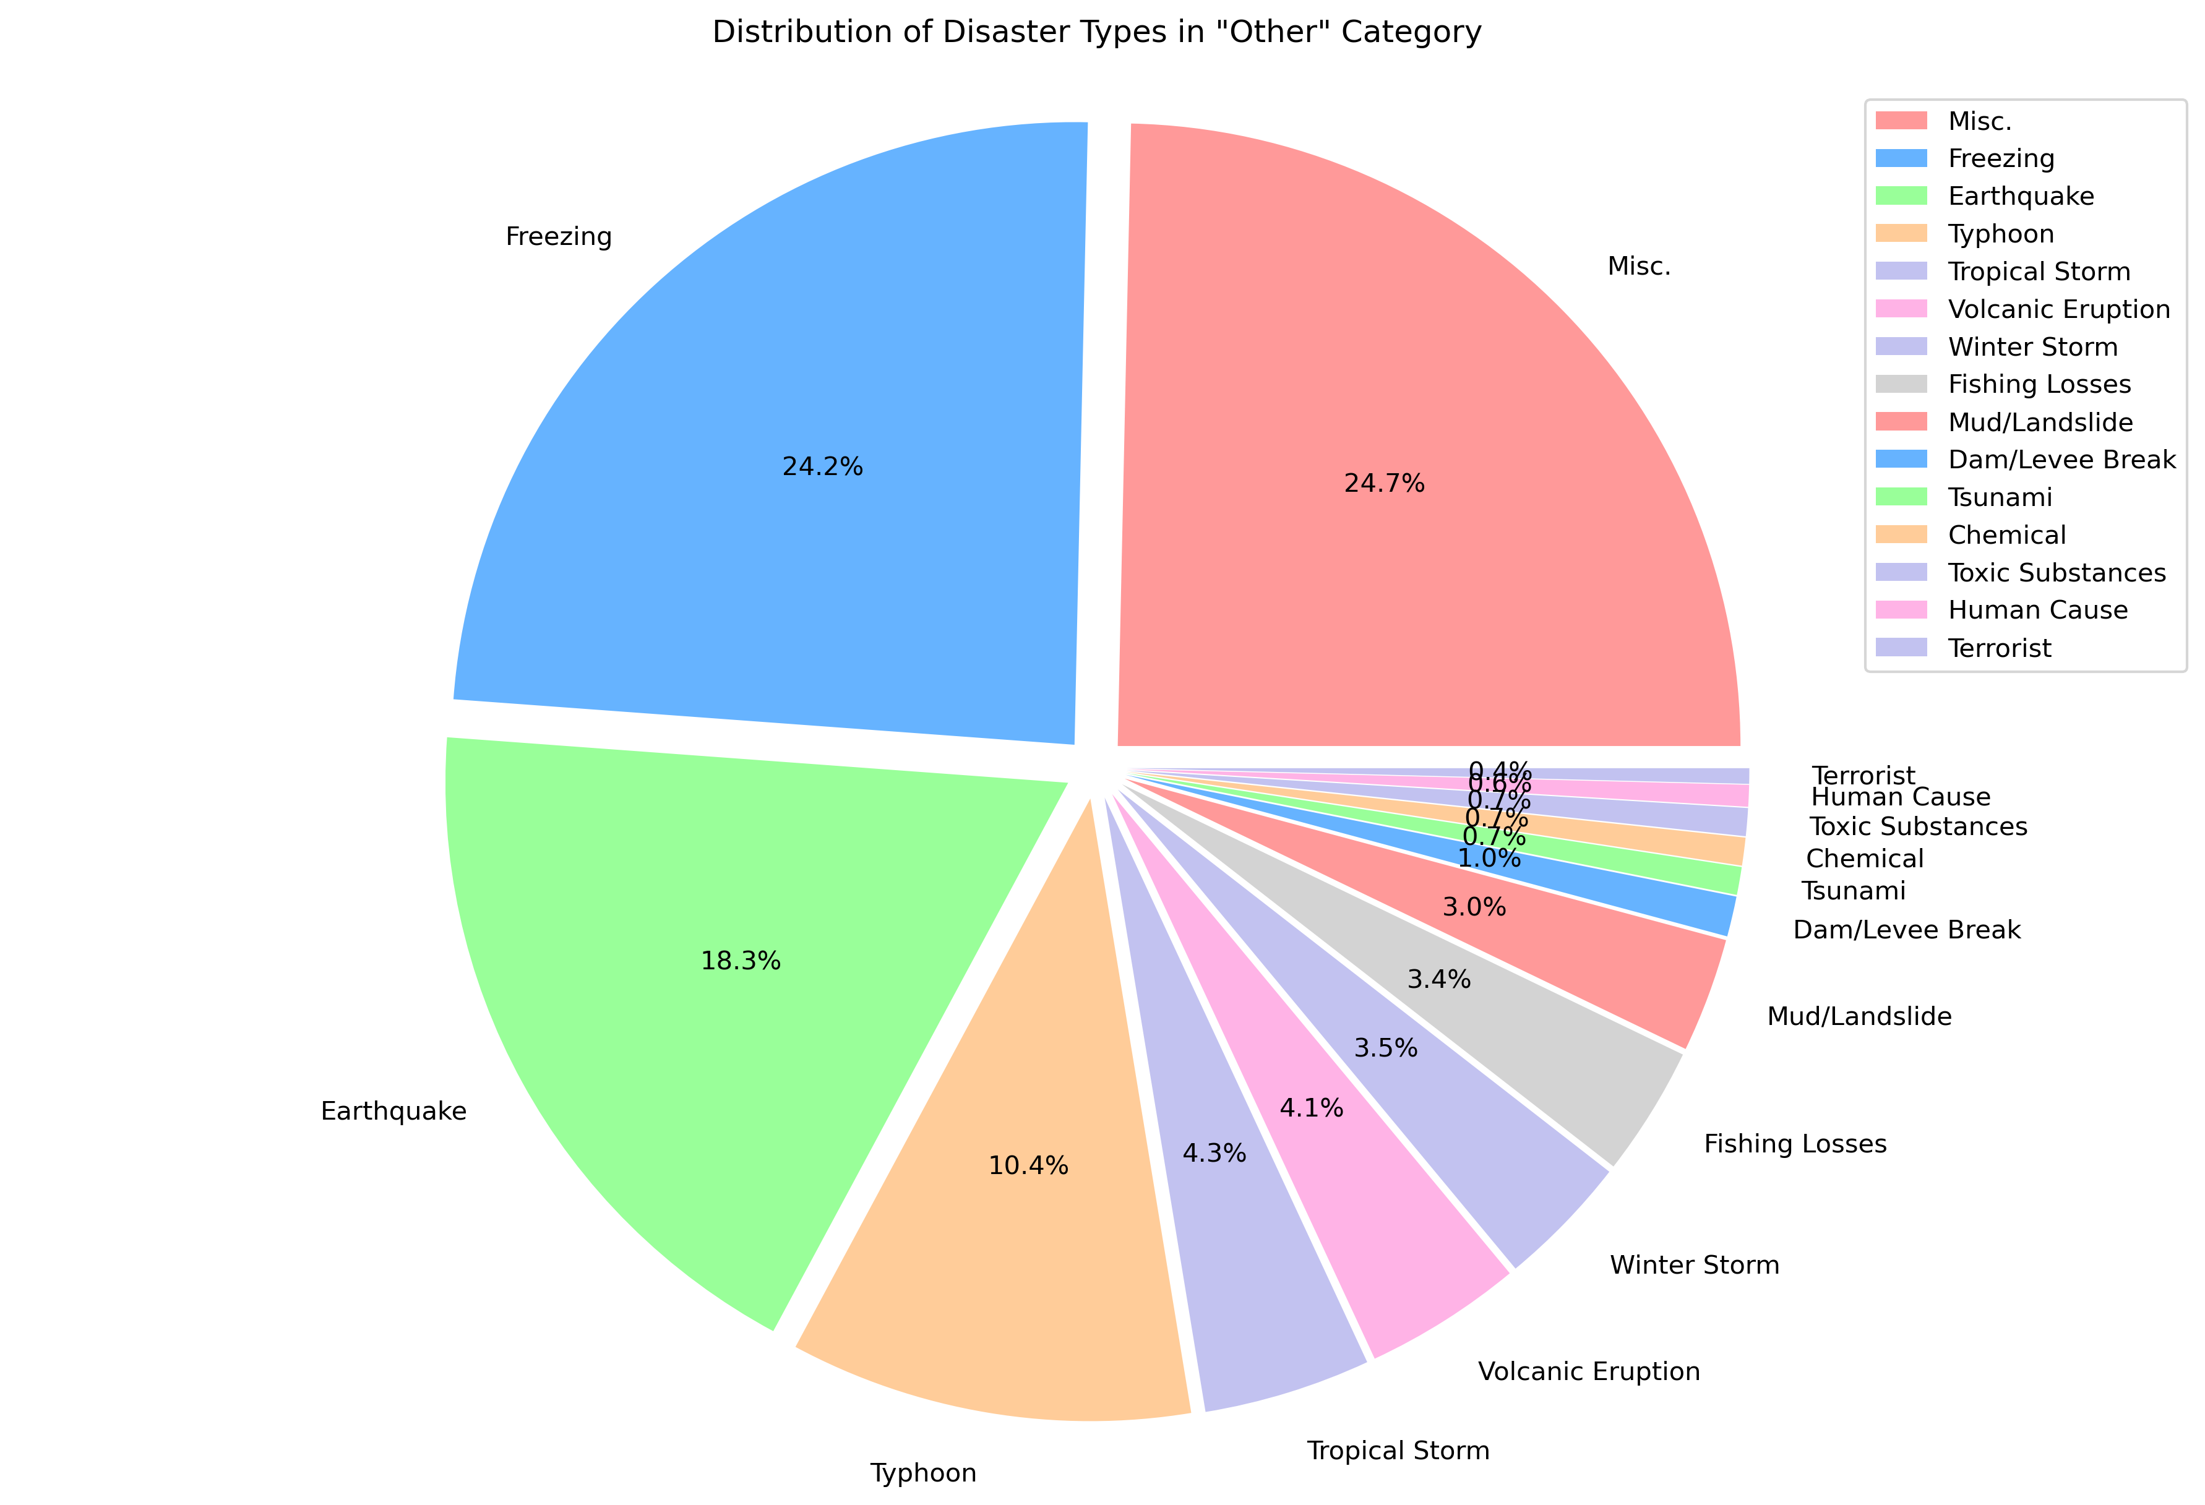



Other:
Upon regrouping the remaining 15 disaster types into an “Other” category, we realized there already was a “other” category listed as a type of disaster within our dataset. We renamed this type as “Misc.” and includes:
- Power Outage/Failures
- High Winds
- Gas Leak Explosions
- Tidal Waves
- West Nile Virus
- Water Shortage
- etc.

Slide 8
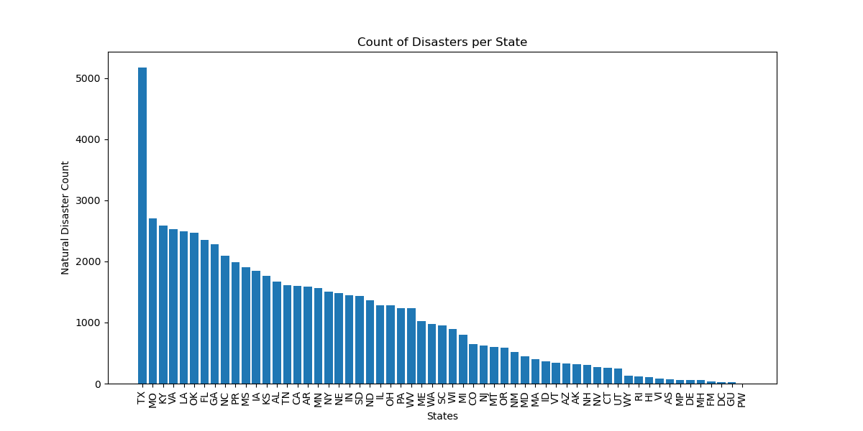
Total amount of natural disaster occurrences per state:

Slide 9
70 years of data
From March 1953 to March 2023
Notes:
angel

Slide 10
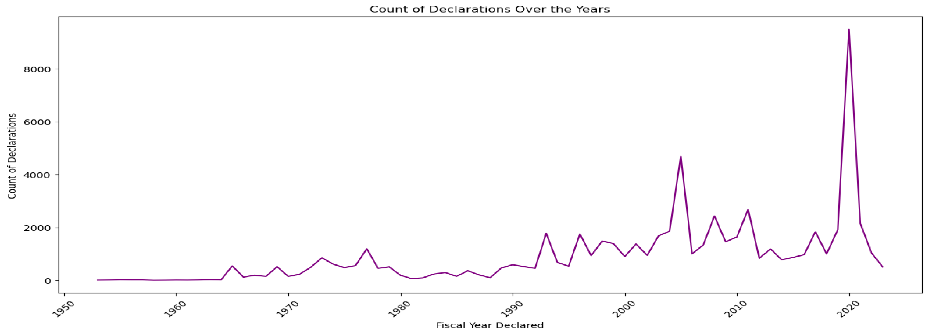
Timeline
Decades of increased declarations
Defining moments in American Disaster History
Hurricane Katrina in 2005
COVID19 in 2020
Lessons to anticipate the future
Notes:
angel

Slide 11
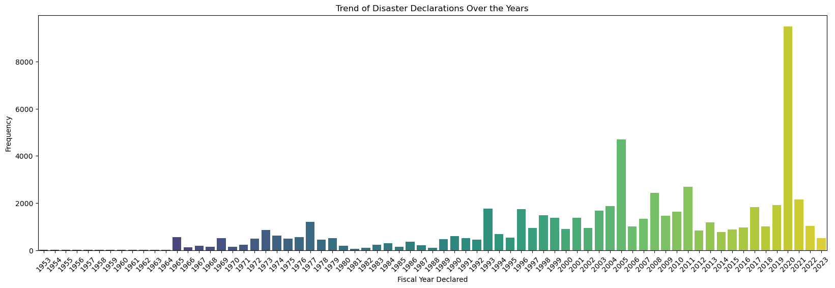
Timeline
Decades of increased declarations
Defining moments in American Disaster History
Hurricane Katrina in 2005
COVID19 in 2020
Lessons to anticipate the future
Notes:
angel

Slide 12

Analyzing Natural Disasters: Frequency and Trends Over the Years
Understanding Disaster Occurrences
Key Takeaways for Decision-Makers
Driving Sustainable Development
Notes:
angel

Slide 13
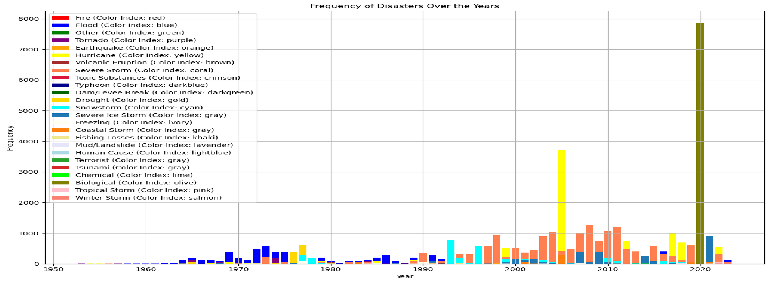
Fluctuations in frequency of different disasters
Flood Disasters & Occurrences
Hurricanes Occurrences
Biological
Notes:
Last angel

Slide 14
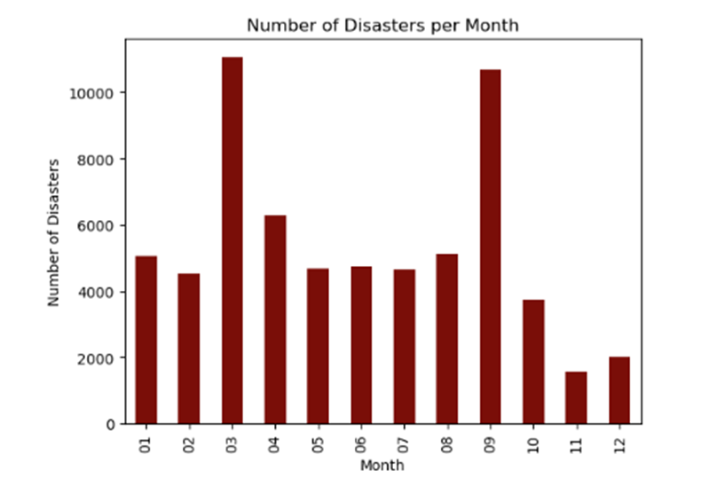
Relationship between Disasters in Months
March and September
November and December
What happens when Covid Disasters are removed?
Notes:
Last angel

Slide 15
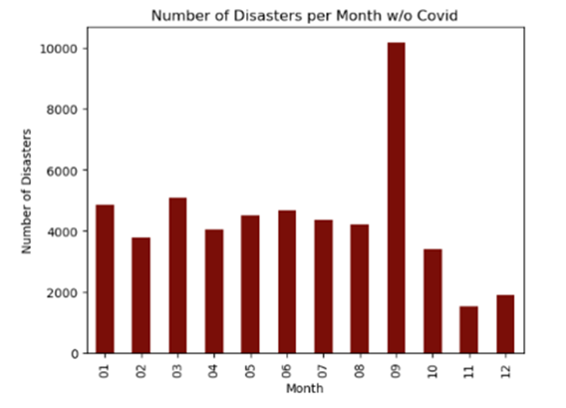
Covid Years Removed
What is going on in September?
How can we prepare?
Notes:
Last angel

Slide 16
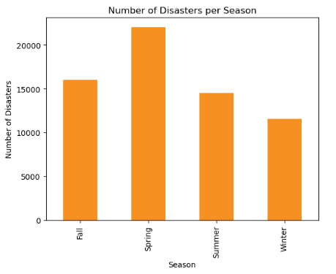
Relationship between Disasters in Seasons
Spring
Winter
What happens when Covid Disasters are removed?
Notes:
Last angel

Slide 17
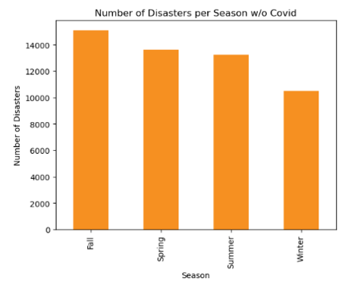
Covid Years Removed
- Fall Takes the Lead
Mitigation Strategies:
Infrastructure improvements
Early warning systems
Community education.
Notes:
Last angel

Slide 18

Regional Disparity in Disaster Declarations
Based on the provided dataset, there are a total of 64,092 natural disaster declarations present. These declarations are distributed across different regions or states in the United States. The visual representation of their distribution shows the number of disaster declarations for each state, providing an overview of the geographical distribution of natural disasters in the dataset.
The bar chart shows the number of natural disasters declarations for each state, giving us an overview how they are distributed geographically across the usa.
How many natural disaster declarations are present in the dataset, and how are they distributed across different regions or states in the US from 1953 to 2023?
Notes:
nathan

Slide 19
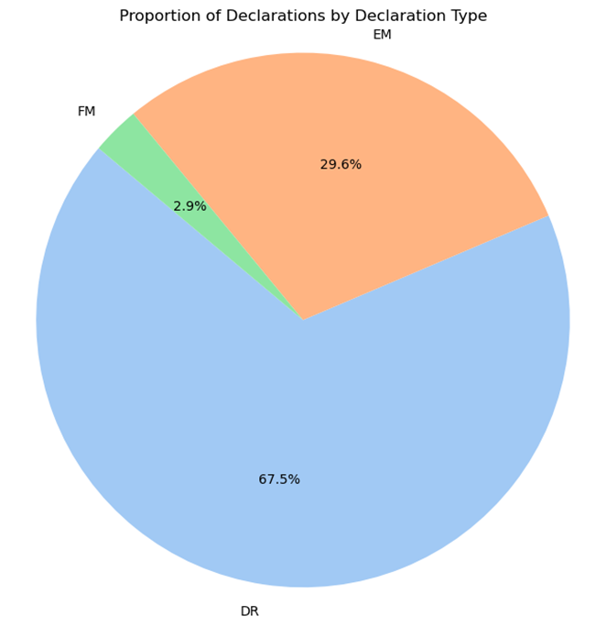
Types of declarations in FEMA
What is DR?
Major Disaster
How many declarations total were made from 1953 to 2023?
43,262 declarations total or 67.5% of total declarations
What us FM?
Fire Management
How many declarations total from 1953 to 2023?
1,859 declarations total or 2.9% of the declarations
What is EM?.
Emergency Management
How many declarations total from 1953 to 2023?
18,971 declarations total or 29.6% of the declarations
3
Notes:
esahn

Slide 20
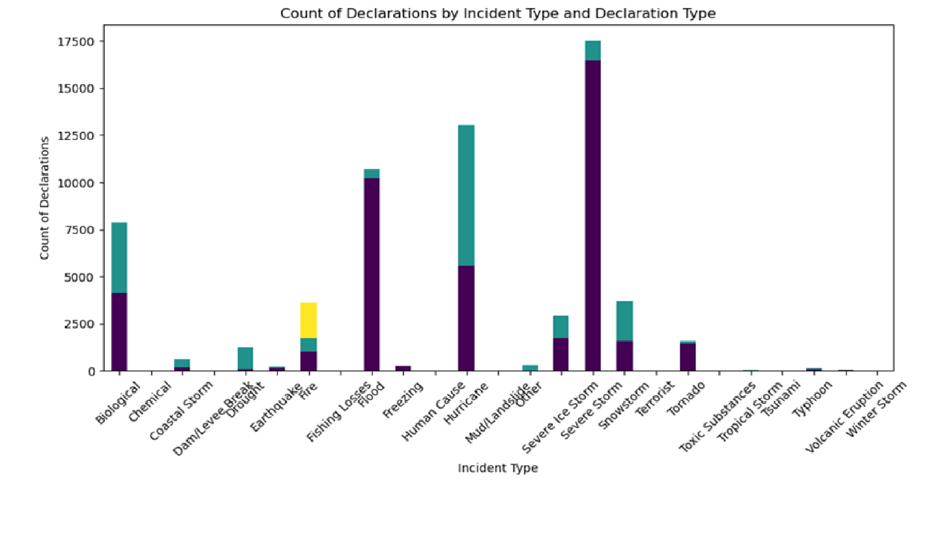
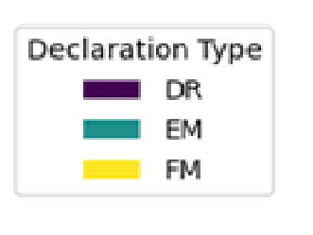
Count of disasters filed as various incident types
Notes:
nathan

Slide 21
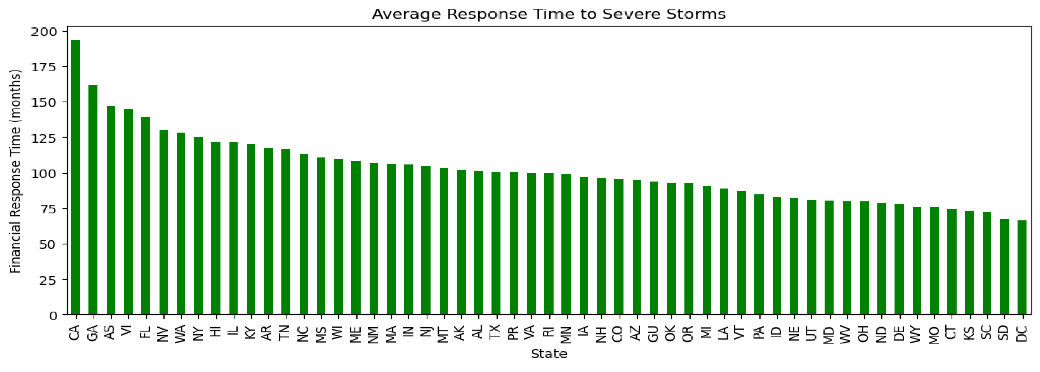
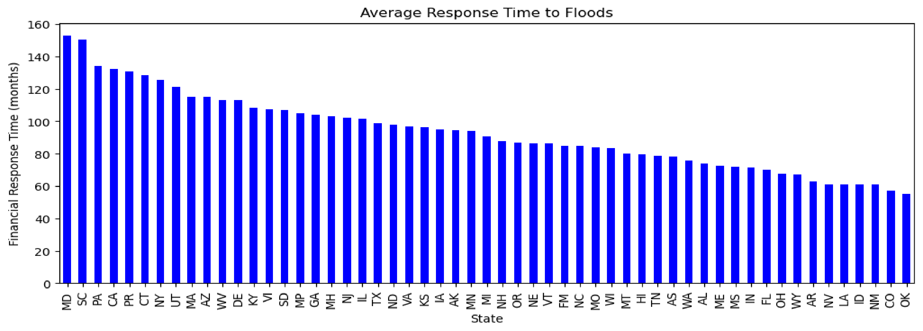
Longest Response Ranges:
Severe Storms emerged as one of the most prevalent natural disasters, accounting for 27.3% of all recorded incidents, highlighting their recurrent nature and significant impact on communities, particularly in regions prone to severe weather events.
Floods also represent a substantial portion of the dataset, accounting for 16.7% of incidents, underlining their recurring occurrence and the critical need for effective floodplain management and preparedness measures.
Notes:
esahn

Slide 22
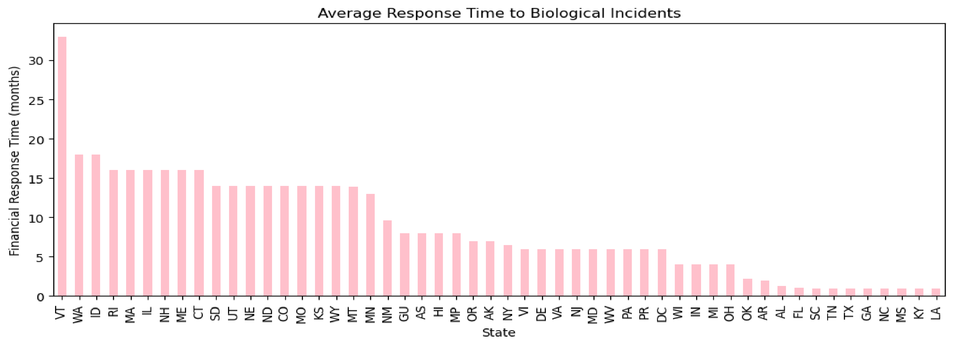
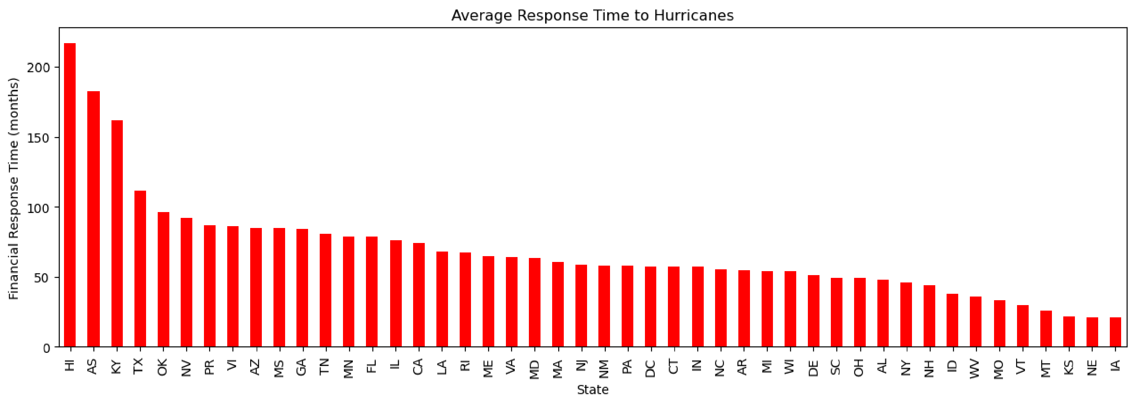
Shortest Response Ranges:
Biological incidents, comprising 12.3% of the dataset, indicate the importance of addressing public health preparedness and response strategies in the face of emerging diseases and pandemics.
Notes:
esahn

Slide 23
Conclusion of our Analysis
Planning for future natural disasters is an imperative responsibility for cities statewide as the frequency and severity of such events continue to rise due to climate change and urbanization. A comprehensive approach that integrates disaster preparedness, mitigation, response, and recovery strategies is essential for safeguarding communities and minimizing the devastating impacts of natural hazards.
What can States do?
Conduct thorough risk assessments to identify the specific natural hazards they are prone to and understanding their vulnerabilities.
Collaboration between local, state, and federal authorities, as well as partnerships with neighboring jurisdictions.
Embracing and investing in advanced technologies and modern communication systems.
Community engagement, education and support of EMS personnel.
Learning from our short-comings and evolve our emergency response methods.
Notes:
Nat

